Slide 1

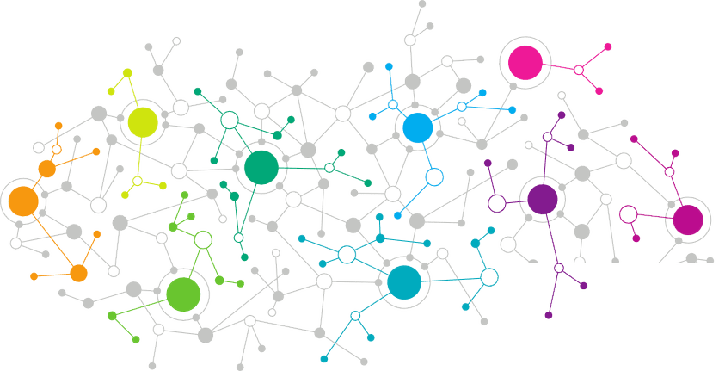

Data Science
Singular Value Decomposition
Notes:
Welcome back to the forth module of data science.

Slide 2
Agenda
01
02
Matrix Factorization
Singular Value Decomposition

Slide 3

Matrix Factorization
 | Movie1 | Movie2 | Movie3 | Movie4 | Movie5
User1 | 4 | 5 | 5 | 4 | 4
User2 | 3 | 3 | 3 | 5 | 4
User3 | 4 | 5 | 5 | 5 | 2
PCA
 | Action | Sci-Fi | Comedy
User1 | 0.3 | 0.5 | 0.2
User2 | 0.1 | 0.1 | 0.8
User3 | 0.3 | 0.6 | 0.1
V
Notes:
One of the world’s leading and pioneering e-commerce giant is eBay which facilitates both<Click event> business to business and <Click Event>business to consumer sales. eBay is a marketplace with a <Click Event> hundred and sixty-two million active customers and <Click Event> 25 million sellers. eBay wanted to make their data as efficient as possible for their buyers and sellers. As they have a total of eight hundred million listings on their site and 8.8 new million listings are being added every week.

Slide 4
Matrix Factorization
 | User1 | User2 | User3
Movie1 | 4 | 3 | 4
Movie2 | 5 | 3 | 5
Movie3 | 5 | 3 | 5
Movie4 | 4 | 5 | 5
Movie5 | 4 | 4 | 2
A^{T}
PCA
 | Action | Sci-Fi | Comedy
Movie1 | 0.6 | 0.3 | 0.1
Movie2 | 0.4 | 0.6 | 0
Movie3 | 0.4 | 0.6 | 0
Movie4 | 0.8 | 0.2 | 0
Movie5 | 0.2 | 0 | 0.8
U
Notes:
One of the world’s leading and pioneering e-commerce giant is eBay which facilitates both<Click event> business to business and <Click Event>business to consumer sales. eBay is a marketplace with a <Click Event> hundred and sixty-two million active customers and <Click Event> 25 million sellers. eBay wanted to make their data as efficient as possible for their buyers and sellers. As they have a total of eight hundred million listings on their site and 8.8 new million listings are being added every week.

Slide 5

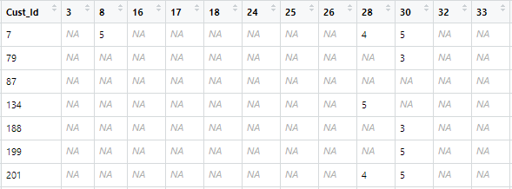
Matrix Factorization
=
U
S
V^{T}
mxn
nxn
mxn
mxm
Orthogonal Matrix
Orthogonal Matrix
Diagonal Matrix
.
=
R_{7,3}
U₇
V^{T} 3
Notes:
One of the world’s leading and pioneering e-commerce giant is eBay which facilitates both<Click event> business to business and <Click Event>business to consumer sales. eBay is a marketplace with a <Click Event> hundred and sixty-two million active customers and <Click Event> 25 million sellers. eBay wanted to make their data as efficient as possible for their buyers and sellers. As they have a total of eight hundred million listings on their site and 8.8 new million listings are being added every week.

Slide 6

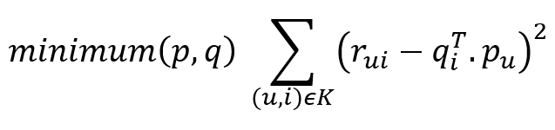
Singular Value Decomposition
Singular value decomposition is a method of decomposing a matrix into three other matrices:
Principal Component Analysis
U
S
V^{T}
Notes:
One of the world’s leading and pioneering e-commerce giant is eBay which facilitates both<Click event> business to business and <Click Event>business to consumer sales. eBay is a marketplace with a <Click Event> hundred and sixty-two million active customers and <Click Event> 25 million sellers. eBay wanted to make their data as efficient as possible for their buyers and sellers. As they have a total of eight hundred million listings on their site and 8.8 new million listings are being added every week.

Slide 7
Singular Value Decomposition
 | Movie1 | Movie2 | Movie3 | Movie4 | Movie4
User1 | ? | 5 | 5 | 4 | 4
User2 | 3 | ? | 3 | 5 | ?
User3 | 4 | ? | 5 | ? | 2
Notes:
One of the world’s leading and pioneering e-commerce giant is eBay which facilitates both<Click event> business to business and <Click Event>business to consumer sales. eBay is a marketplace with a <Click Event> hundred and sixty-two million active customers and <Click Event> 25 million sellers. eBay wanted to make their data as efficient as possible for their buyers and sellers. As they have a total of eight hundred million listings on their site and 8.8 new million listings are being added every week.

Slide 8
Singular Value Decomposition
 | Movie1 | Movie2 | Movie3 | Movie4 | Movie4
User1 | ? | 5 | 5 | 4 | 4
User2 | 3 | ? | 3 | 5 | ?
User3 | 4 | ? | 5 | ? | 2
.
=
A_{User1,Movie1}
U_{User1}
V^{T} Movie1
Minimizing with Stochastic Gradient Descent (SGD)
Notes:
One of the world’s leading and pioneering e-commerce giant is eBay which facilitates both<Click event> business to business and <Click Event>business to consumer sales. eBay is a marketplace with a <Click Event> hundred and sixty-two million active customers and <Click Event> 25 million sellers. eBay wanted to make their data as efficient as possible for their buyers and sellers. As they have a total of eight hundred million listings on their site and 8.8 new million listings are being added every week.

Slide 9
Thank You

Slide 10

India : +91-7847955955
US : 1-800-216-8930 (TOLL FREE)
sales@intellipaat.com
24/7 Chat with Our Course Advisor
Notes:
Thank you!

